Slide 1
Trust - Accountability – Client Centric – Teamwork
Pacific Component Xchange, Inc.
Call:
Sara Burrell – 714-374-3070 ext 2001
Or
Dave Cox – 714-374-3070 ext 2005

Slide 2
Celebrating Excellence Since 1993!
PCX has been in business since 1993 with a solid reputation for outstanding service, quality,
and on time delivery. We are here for the long haul. We back all our products and services 100%.
Over 300 authorized lines (60+ electronics lines). A broad line distributor of products and value
added services.
Over 1 billion obsolete, hard to find & EOL parts in stock, all quality inspected and ready to ship.
What you need, when you need it.
Global sourcing capabilities with over 23 years in relationships. The world at your fingertips with one
phone call or email.
Star Quality Inspection Program, our proprietary inspection program which includes full counterfeit
mitigation with in-house x-ray. You are guaranteed to receive fully inspected, authentic products
every time.
Full testing capabilities with certified 3rd party test partners. We meet or exceed all special inspection
& service requirements as required by your PO.
AS9120 Rev. A/ISO 9001-2008 Certified. Fully accredited processes and facilities by 3rd party
registrars.
ANSI ESD s.2020-2014 Certified. Fully accredited processes and facilities by 3rd party registrars.
Major contract supplier to US Government, DLA, DSCC and all military branches. These customers
have the strictest guidelines around quality, service and on time delivery. We give the same
service to all our customers

Slide 3
Commitment to Quality
ISO 9001:2015 Certified
AS9120 Rev B Certified
ANSI ESD S20.20 - 2014 Certified
IDEA QMS9090 Certified
QSLD certified supplier for DSCC (5961 & 5962)
Climate controlled warehouse
Star Quality Program proprietary 67 step inspection process
Experienced Warehouse Staff with specially trained QC and QA teams
Member ECIA (Electronic Components Industry Assoc.)
Member E.R.A.I and I.D.E.A
Member ASA (Aviation Suppliers Association)

Slide 4
Commercial Services
Sourcing of hard to find/allocated components
300+ Lines of Franchised/Authorized products
VMI, Consignment, JIT and Bonded Inventory programs
Generous Payment terms and flexible Credit Limits
Market Analysis and Commodity Information
Kitting Services

Slide 5
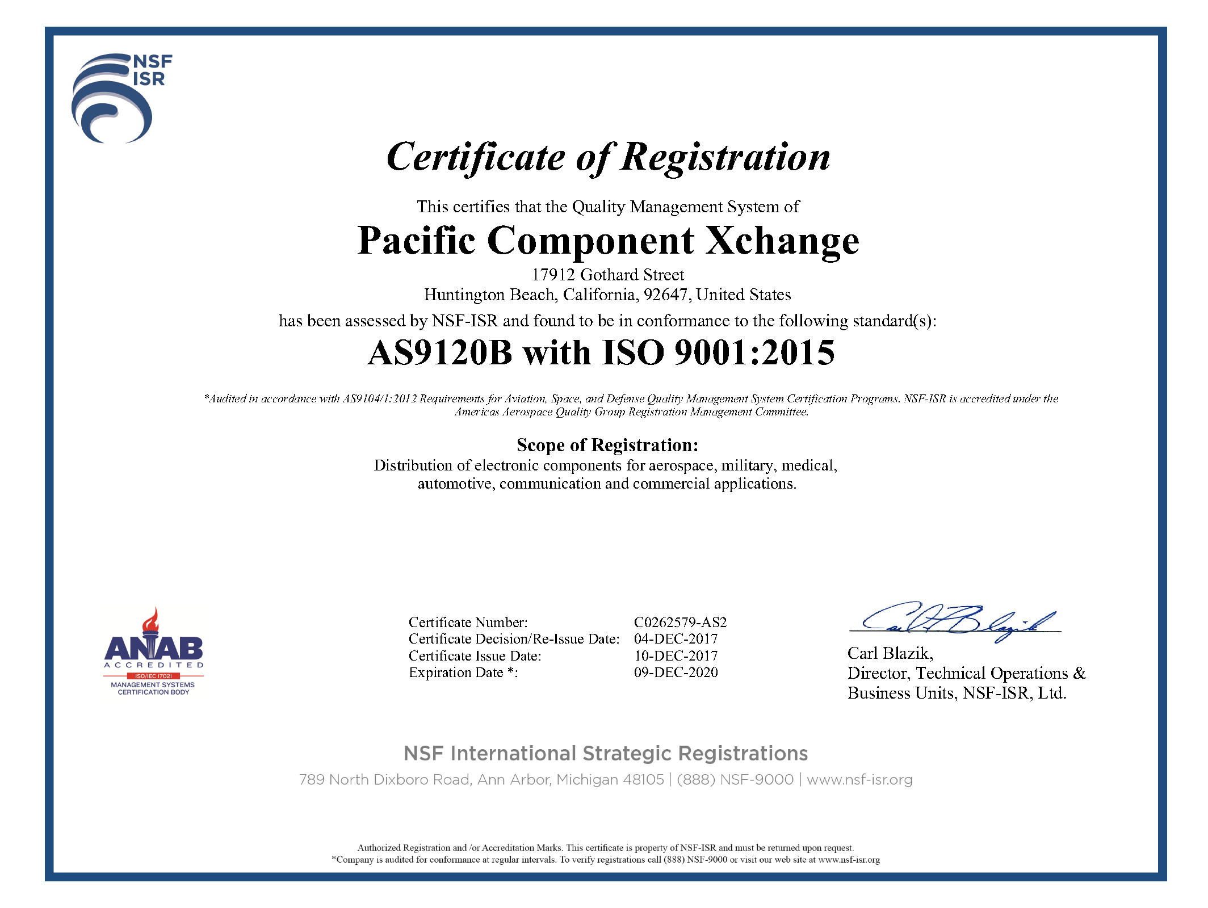

Slide 6
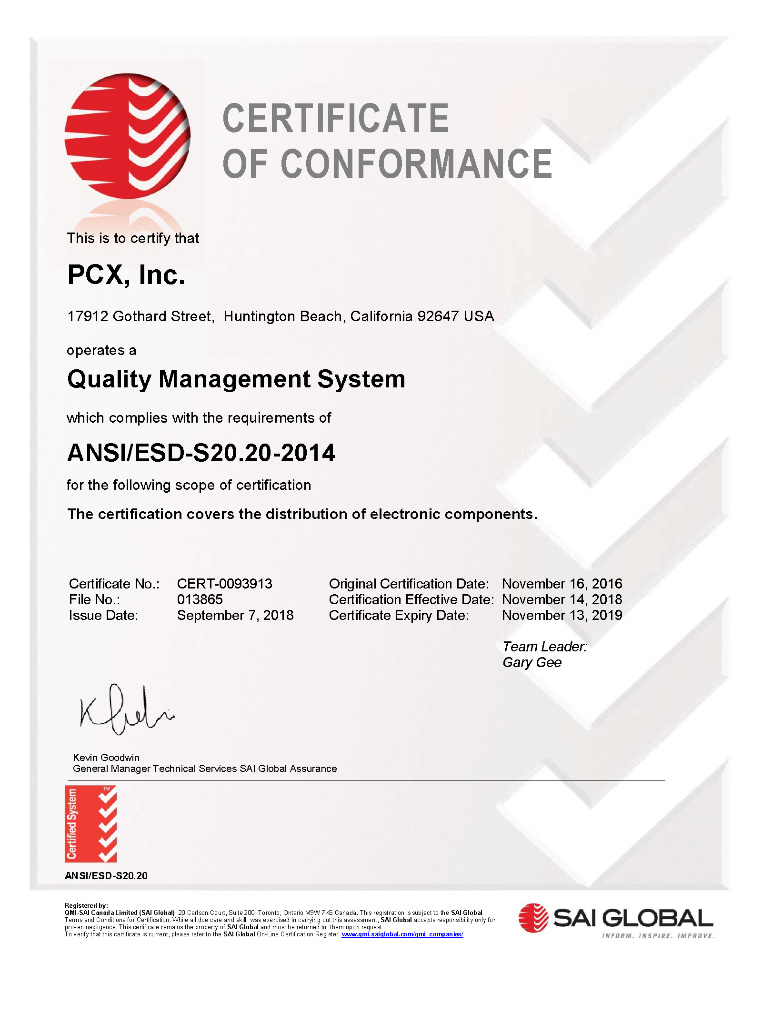

Slide 7
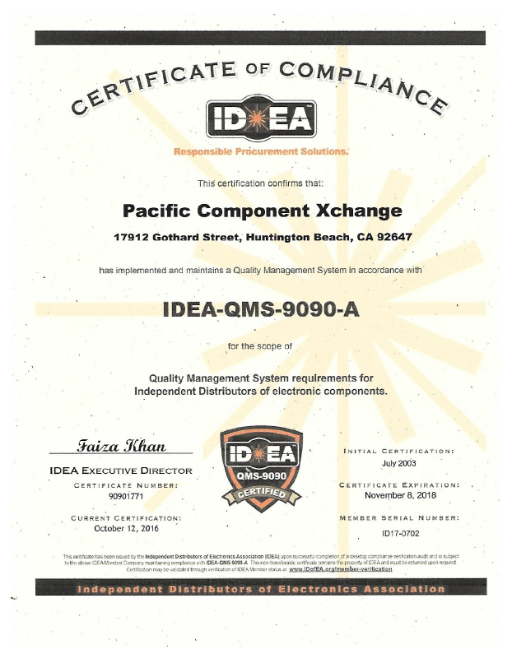

Slide 8
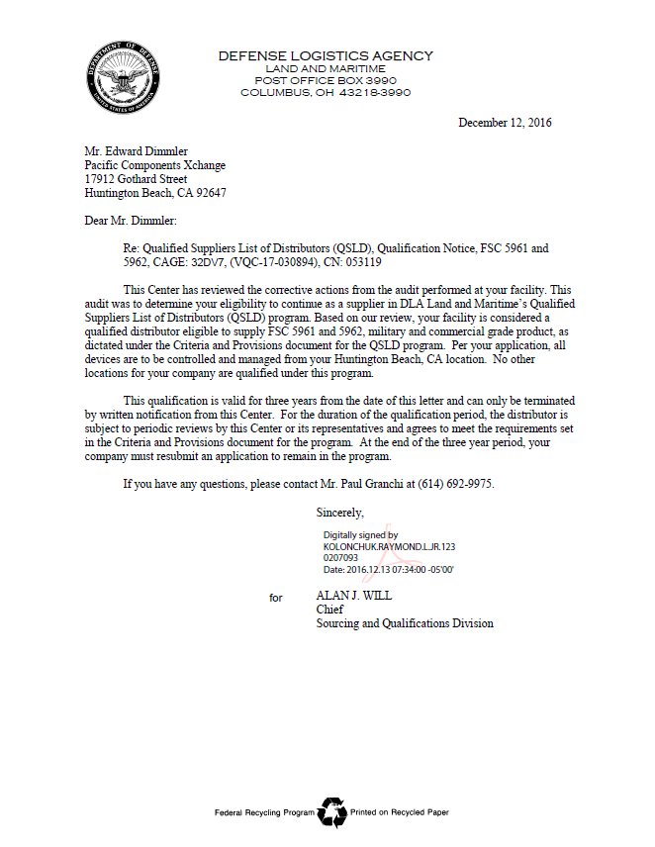

Slide 9
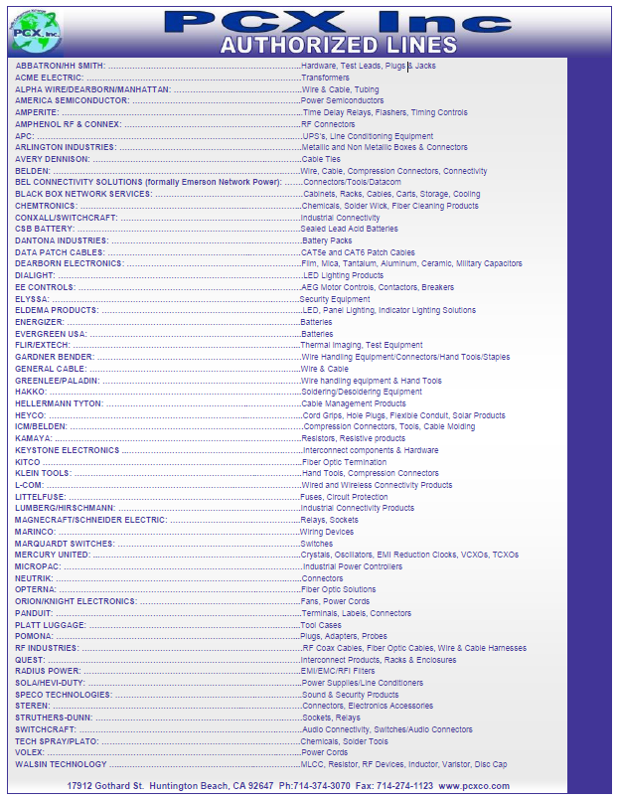

Slide 10
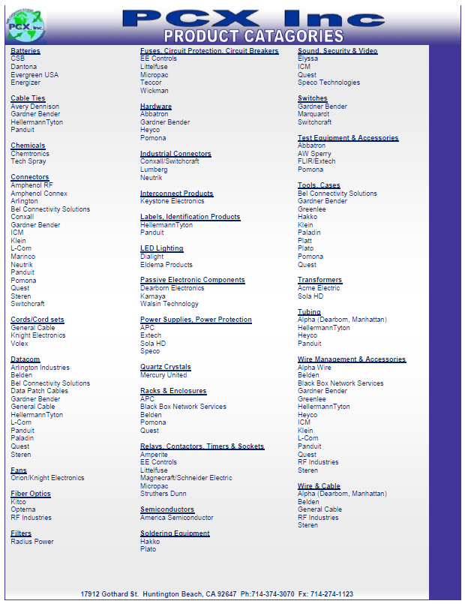

Slide 11
Commodities: FSC/NAICS codes
PCX is a broad line stocking distributor. We carry or source the following commodities (list our capabilities by FSC and NAICS code):
FSC Codes
1220, 1230, 1240, 1290,1615, 1620, 1630, 1680, 1710, 1730, 2590, 2610, 2620, 2630, 2805, 2810, 2815, 2820, 2825, 2835, 2840, 2940, 2945, 2990, 2995, 3020, 3030, 3110, 3120, 3020,3030, 4110, 4120, 4130, 4140, 4210, 4220, 4240, 4310, 4340, 4460, 4510, 4610, 4710, 4720, 4730, 4810, 4820, 4910, 4920, 5110, 5120, 5130, 5133, 5136, 5180, 5210, 5220, 5305, 5306, 5307, 5310, 5320, 5325, 5330, 5335, 5340, 5345, 5350, 5355, 5360, 5365, 5805, 5820, 5821, 5825, 5826, 5840, 5855, 5895, 5905, 5910, 5915, 5920, 5925, 5930, 5935, 5940, 5945, 5950, 5955, 5960, 5961, 5962, 5963, 5970, 5975, 5977, 5980, 5995, 5996, 5998, 5999, 6004, 6010, 6015, 6020, 6026, 6030, 6040, 6060, 6070, 6099, 6105, 6110, 6115, 6120, , 6125, 6130, 6135, 6140, 6145, 6150, 6240, 6250, 6340, 6545, 6605, 6610, 6620, 8030, 8040, 8135, 8340,
NAICS Codes
221121, 238210, 334413, 335312, 335313, 335912, 335931, 335999, 336212, 337214,
339113, 423430, 423610, 423690, 423710, 423830, 423840, 424690, 484121, 541310, 541330, 541340, 541410, 541519, 562213, 811212, 811219, 811310

Slide 12
Partial Authorized Lines List
Hawker/Beechcraft Avionics Parts, Engines, Substrates
Abbatron/HH Smith Hardware, Test Leads, Plugs & Jacks
Trival Antene Antenas
Guardian Electric Relays, Connectors, Switches, caps, resistors
ACR Electronics Marine Electronics, Lighting, signal equipment
Burndy Connectors, fittings, tools
Dearborn Electronics Caps, resistors, thermistors
Avtron Aerospace Aeronautic test equipment
Bushnell Optics, weapon parts, holsters, binoculars
Champion Aviation Aeronautics systems and parts
Pratt & Whitney Aircraft engines, systems
Concorde Battery Corp. Batteries and battery systems
Dunlop Tires Tires and tread systems
TCM Engines Aeronautic engines
Whelen Engineering Warning and signaling devices
Bell Helicopter Helicopter systems and parts

Slide 13
Partial Authorized Lines List
Dantona Battery Packs
Emerson/AIM Connectors/Tools/Datacom
Eveready Batteries
Kamaya SMD Resistors
Littelfuse Fuses, Circuit Protection
Mercury United Crystals, Oscillators, VCXO, TCXO, VTCXO,OCXO
Goodrich Sensors, signal systems
Goodyear Tires, tread systems, landing systems
Meggit Extreme environment components
Securaplane Avionics energy storage, power electronics
East Penn Manufacturing co., Inc. Batteries, energy systems
Deka Batteries, energy systems
Sanyo Semiconductor Full line of semiconductor products
Sanyou Relays Relays
Sola Power Supplies/Line Connectors
Southwest Products Avionics parts and subsystems

Slide 14
Partial Authorized Lines List
Switchcraft Switches/Audio Connectors
Tech Spray Chemicals
Volex Power Cords
UMPCO Inc. Clamps, clips, brackets
Mustang Survival Survival gear
Powersonic Corp. Batteries
Pentair Engines
ACR Electronics Survival gear
Ingersoll Rand Construction Equipment
Harlan Global Manufacturing Construction Equipment
Hubbell Wiring Device Wire Devices
Rubbermaid Rubber products
Conax Technologies Connectors
Sta-rite Industries Misc. Electronics

Slide 15
Partial Authorized Lines List
Baldor Electronic Co. Electrical Equipment
Carlin Technologies Electronics
Honda Motor Motors
Navico Maritime Electronics
Dialight LED products

Slide 16
Value Added Services
In House Services
Oxygen Cleaning
Clean room bearing packaging
Taping and Reeling individually – large and small runs
Vacuum Sealing to proper ESD Specifications
Bar Coding and other special labeling and packaging
X Ray
Military Spec Packaging
Scheduled order capabilities
Security/locked processing area
Outsourced Solutions
Basic Electrical testing
Solder testing
DE capsulation
Erasing / Programming
Upgrading from Commercial to Industrial Temperature
Part Screening

Slide 18
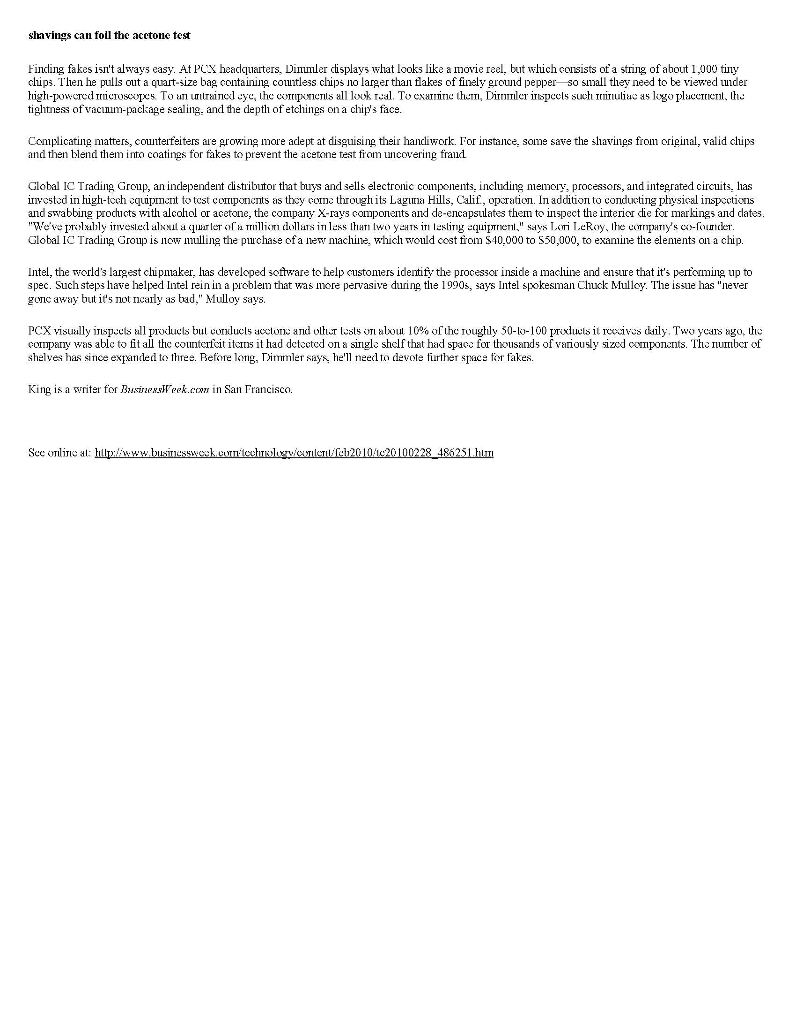

Slide 19
Star
Quality
Program
PCX
67 Step
Quality
Inspection
Process

Slide 20
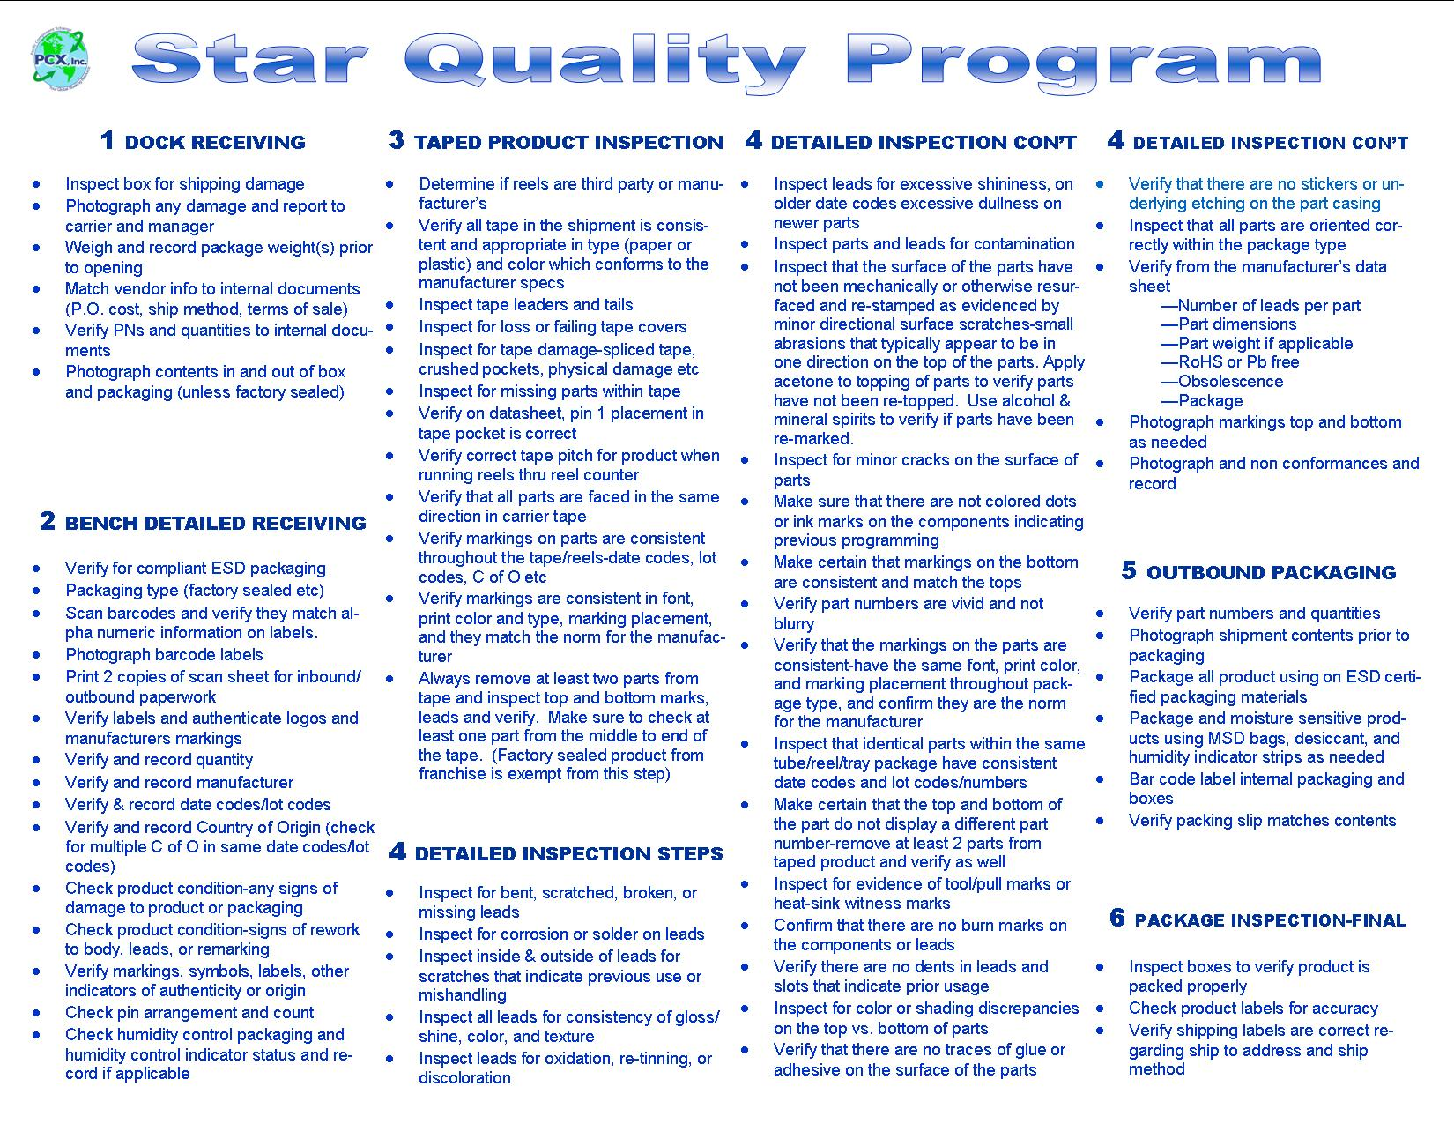

Slide 21
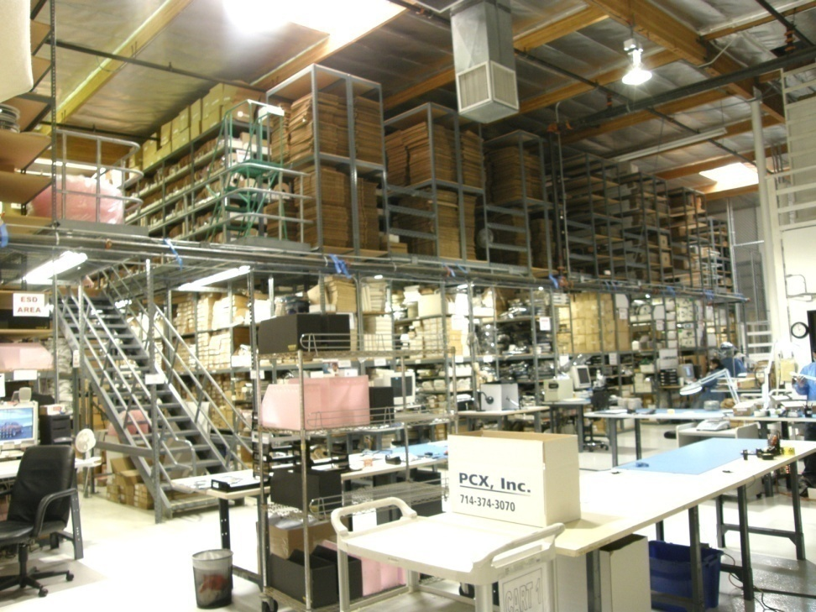
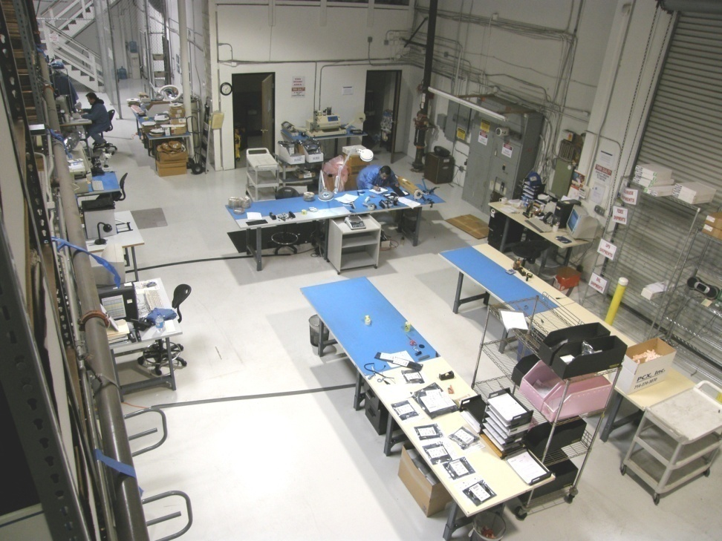

Slide 22
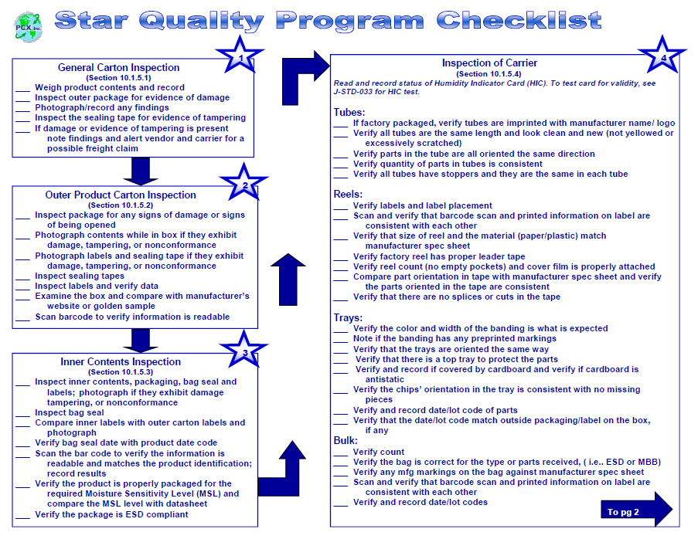

Slide 23
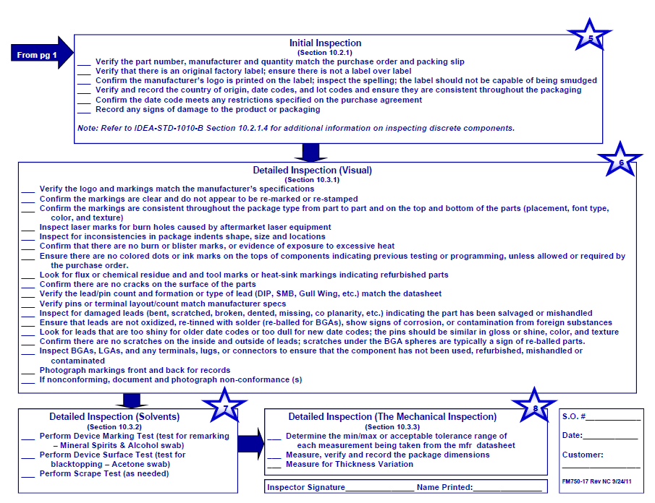

Slide 24
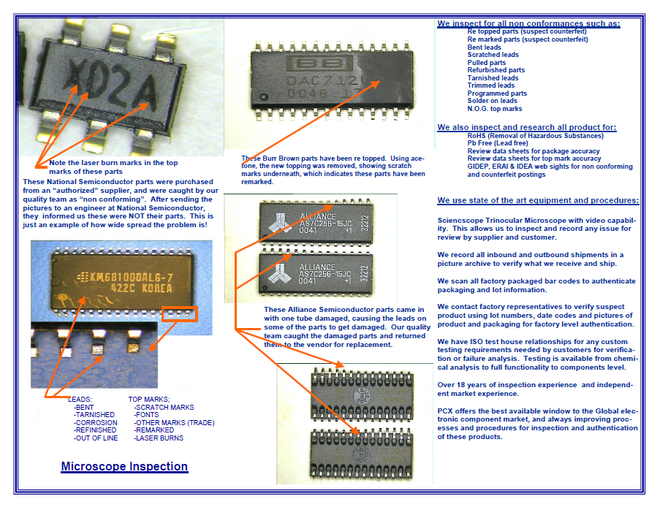

Slide 25
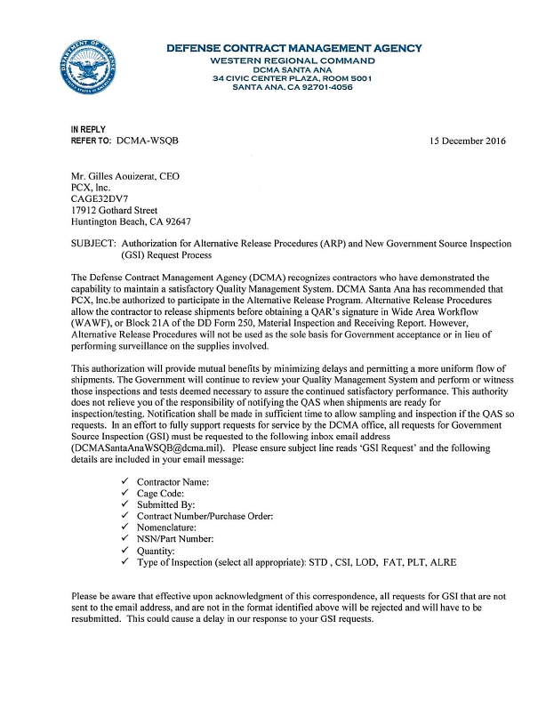

Slide 26
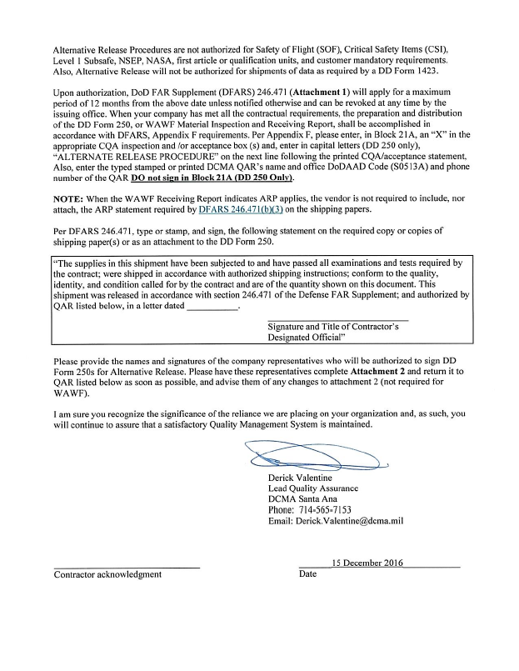

Slide 28
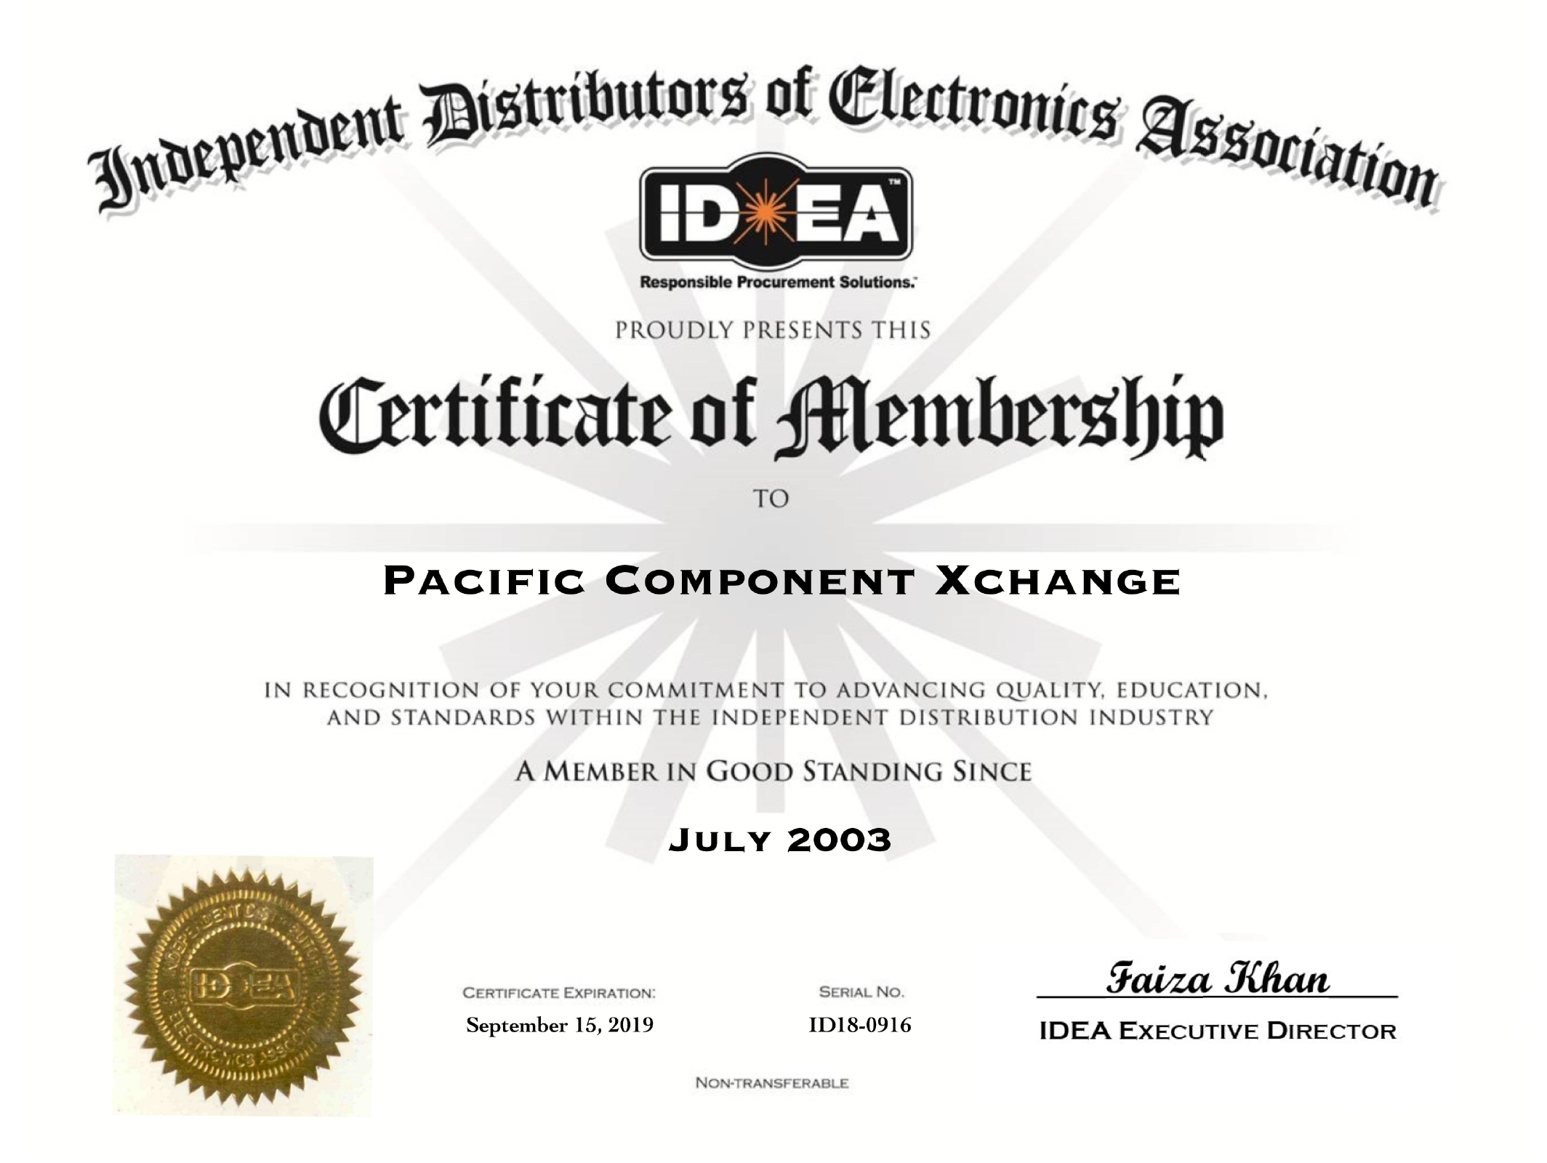

Slide 29
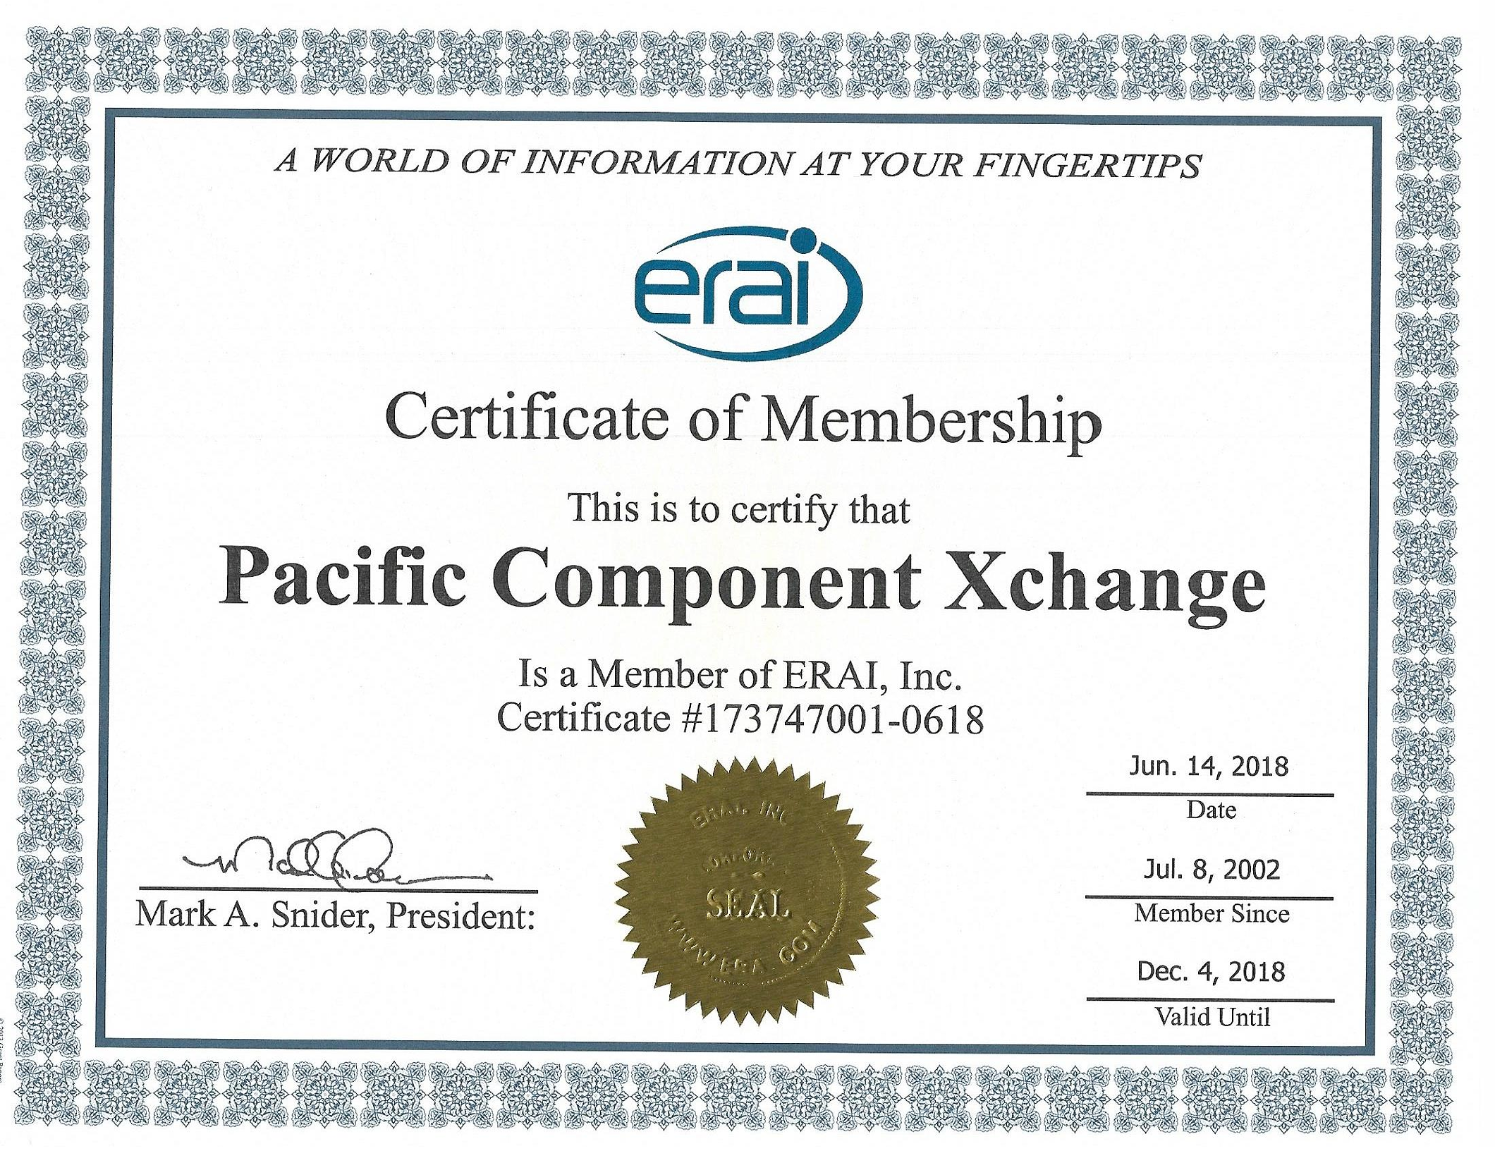

Slide 30
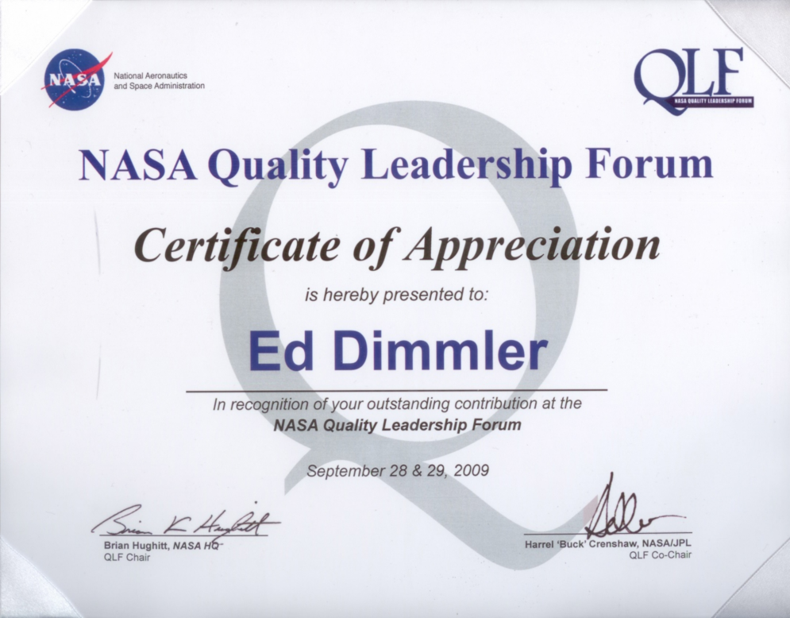

Slide 31
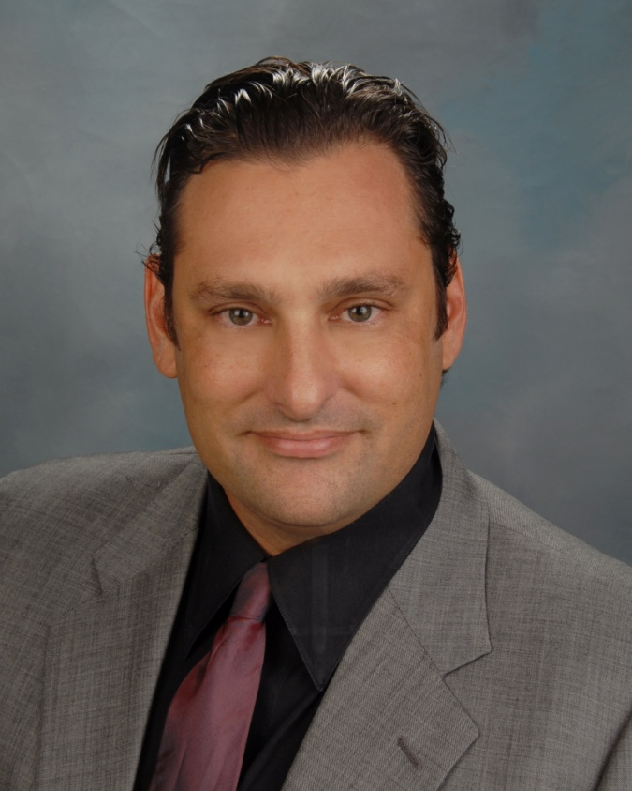
Management Team
Gilles Aouizerat – CEO
Gilles has over 14 years of experience in the Independent distribution market and has built PCX into a respected and successful company with a focus on satisfying customers. Gilles graduated with a Bachelor of Science degree in Political Science from the University of California, Riverside. Mr. Aouizerat is responsible for the direction of PCX and overseeing the overall operations of the company.
His commitment to service and support is well known. He believes that ‘the buck stops with me’ and that accountability, accessibility, and creativity in being a supply solution partner are of paramount importance.
His direct number is 714-374-3214 and his email is gil@pcxco.com.

Slide 32
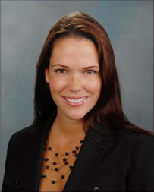
Management Team (Cont.)
Sara Burrell-VP Commercial Sales
Sara Burrell is a 16 year veteran of PCX, Inc. who has held several management positions in the company including Warehouse Manager, Quality Manager, Director of Distributor Sales, Director of Sales and now VP of Sales.
Sara brings a deep bench of experience in all aspects of the organization enabling her to support our staff, clients, vendors very effectively.
Her direct number is 714-374-3218 and her email is sara@pcxco.com

Slide 33
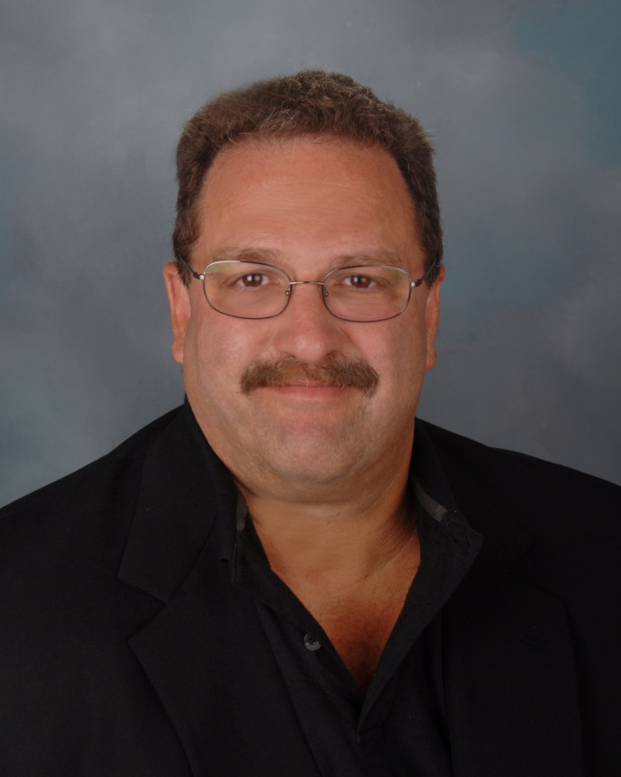
Management Team (Cont.)
Edward Dimmler – Director of Quality
As Director of Quality, Ed is responsible for maintaining and improving our quality processes and ensuring our operations are running as effectively and efficiently as possible. Our proprietary Star Quality Program, a 67 step visual inspection process, is just one of the many PCX differences Ed helped to develop. Ed brings more then 29 years of experience in Independent Distribution.
His direct number is 714-677-1286 and email is ed@pcxco.com

